Slide 1


Abstract Writing

Slide 2
Abstract
The abstract should be the best part of the paper!
It is the most frequently read part of an article after the title.

Slide 3
Purposes of the Abstract
Scientific abstracts:
introduce journal articles
inform readers about the article’s content
help readers decide whether or not to read article
overview conference programs, abstract collections, and book chapters

Slide 4
Why Should I Know How to Write Abstracts?
Helps you present complex information in a clear, concise manner
Helps you read abstracts more effectively
Helps you conduct research
Helps you write abstracts for future publications
Helps you condense report information into a short format for database searches

Slide 5
Qualities of an Effective Abstract
A well-developed paragraphs, which are unified, coherent, concise, and able to stand alone (200-300 words)
Use an introduction-body-conclusion structure in which the parts of the report are discussed in order: purpose, research questions, methods, findings, conclusions, recommendations
Follow strictly the chronology of the report

Slide 6
Add no new information - merely summarizes report
Contain stand-alone qualities - the abstract can be understood without reading the paper

Slide 7
Remember that an abstract typically contains:
Topic,
Research question,
Methods,
Results,
Conclusion
Recommendation

Slide 8
Topic sentence - Introduction (optional)
Introduces the topic of the study and the reasons for its investigation.
Subject/Purpose
What is this project about? Why is this project interesting or important?
Hypothesis/Prediction What did you think you would find? Why?
Approach/Methodology Briefly explain the approach/methodology you followed in order to test your prediction.
Findings/Discussion What did you find when you performed your test? And are your results consistent with your initial hypothesis and prediction? Why or why not?
Conclusion What do these results mean? Why should anyone become excited or interested in your findings?

Slide 9
Writing the Parts of My Abstract
Step-by-Step Process:
Write 1-2 introduction sentences that explain topic, purpose, and research question(s).
Write 1-2 sentences describing your research methods (this may also include the type of data analysis you used).
Write 1-2 sentences describing the results / findings.
Write 1-2 sentences containing your conclusions and recommendations.
Notes:
Many publications have strict word count requirements for abstracts and articles. Use the guidelines on this slide as suggestions for structure and content but always check with the publication and editor with whom you are working to determine their particular abstract requirements.

Slide 10
What is an abstract?
There are four main types of abstracts, all of which summarize the highlights of your research and all of which will be judged in isolation. Abstracts are sometimes called Summaries.
Abstracts are found before a full article in a journal, standalone in databases of abstracts, and in conference programs.

Slide 11
Types of Abstract
informative
descriptive
critical
highlight abstracts.

Slide 12
Unstructured abstract
A single paragraph of between 100–250 words containing a very brief summary of each of the main sections of your paper
Structured abstract
The same as (1) but divided into several short sections

Slide 13


Slide 14
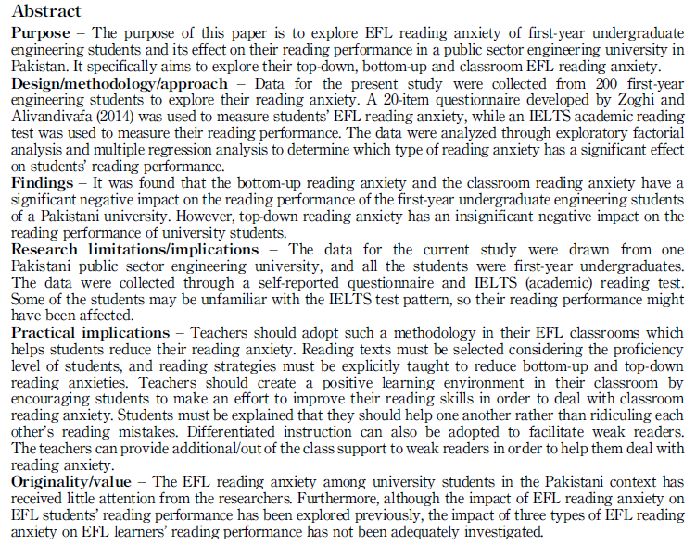

Slide 15
This research paper attempts to find out students’ writing problems at secondary level. Students of this level face many problems but grammatical errors are the biggest problem for most of the students. Apart from grammatical problems, problems with information organization, translation problems, spelling mistakes and using inappropriate vocabularies are common problems among the students. For data collection and data analysis the researcher observed three different classes of one school, took 30 students’ interview and assessed 30 scripts. After the data collection and data analysis the researcher found that students face writing problems not only due to inabilities but also for the drawback in the education system. The paper concludes by stating some limitations of the study and scopes for the future investigation.

Slide 16
Purpose: This research paper attempts to find out students’ writing problems at secondary level. Students of this level face many problems but grammatical errors are the biggest problem for most of the students. Apart from grammatical problems, problems with information organization, translation problems, spelling mistakes and using inappropriate vocabularies are common problems among the students.
Method: For data collection and data analysis the researcher observed three different classes of one school, took 30 students’ interview and assessed 30 scripts.
Results: After the data collection and data analysis the researcher found that students face writing problems not only due to inabilities but also for the drawback in the education system.
Conclusion: The paper concludes by stating some limitations of the study and scopes for the future investigation.

Slide 17
Abstract:
The present study seeks to identify or Examining the Academic Writing Challenges Faced by University Students in KFUEIT. A qualitative descriptive analytic investigation was utilized to achieve this goal. Questionnaires for university students were designed to collect data. The sample includes 40 students in which 20 were male and 20 were female students. The key findings show that students have a number of challenges when it comes to academic writing, particularly in terms of word choice, vocabulary, and paraphrasing. The instructors' questionnaire gives same results in terms of problems, with critical writing and style being named as the most challenging. Teachers criticize these challenges on a lack of writing skills and practice, according to the research. In moreover, the majority of participants consider that the time allotted for undergraduate studies is insufficient. When making recommendations, students, teachers, and curriculum designers must examine the findings.

Slide 18
ABSTRACT: The purpose of this study was to investigate the relationship between English learning anxieties (communication anxiety, test anxiety, and fear of negative evaluation), among EFL non-English major students. The participants of this study consisted of 254 freshmen at a continuing school in Taiwan, including 109 female students and 145 male students. A questionnaire ELAS (English Learning Anxiety Survey), for the purpose of understanding participants’ inner thoughts in terms of English language learning anxieties among three categories, was partially edited from FLCAS (foreign language classroom anxiety scale) and partially designed by the researcher. The data was then analyzed by using descriptive statistics, ANOVA, Scheffe Post Hoc Test. The results showed that there were statistically significant differences on the English Learning Anxiety Scale (ELAS) with respect to the three categories of communication anxiety, test anxiety, and fear of negative evaluation among EFL college freshmen. Also of the three categories of English learning anxiety, the highest mean score across the items was test anxiety, followed by communication anxiety and fear, and finally of negative evaluation. Additionally, students whose majors were Commercial Design had the highest anxiety scales,
followed by those who majored in Industrial Engineering & Management and Cosmetology and Styling. The lowest anxiety level was among students majoring in Mechanical Engineering, followed by those who majored in Applied Foreign Languages and Electrical Engineering.

Slide 19
The type of abstract you choose and the format to use will depend on the journal or conference. Make sure you read their instructions to authors before you begin writing.

Slide 20
When should I write the Abstract?
Write a rough draft of the abstract before you start writing the paper itself. This may
help you to decide what to include in the paper and how to structure it. But experienced
writers always write the Abstract (and often the Introduction too) last, i.e. when
they have finished the rest of the paper. This reflects the research process itself - the
first thing you write about is what you found, then how this can be interpreted.

Slide 21
How should I structure my Abstract?
An Abstract generally answers at least the first three of the following questions, and
generally in the following order. You can use the answers to these questions to
structure your Abstract.
Why did I carry out this project? Why am I writing this paper?
What did I do, and how?
What were my results? What was new compared to previous research?
What are the implications of my findings? What are my conclusions and/or
recommendations?
To decide what to include it may help you to go through your paper and highlight what you consider to be the most important points in each section.

Slide 22
How should I begin my Abstract?
When you read an advertisement for a product it never begins The objective of this
advertisement is to convince you to buy … Instead advertisers go straight to the
point. Abstracts are like advertisements for your paper.
You want your abstract to stand out so that there will be a better chance someone will notice it and read it. If you begin your abstract with commonly used phrases (by both native and non native English speakers) such as This paper deals with …The aim of this paper … This article explores … We report … you are not differentiating yourself from the others. In fact, some journals advise against using such expressions.

Slide 23
PHRASES FOR WRITING ABSTRACTS
The paper presents…
The article deals with …
The paper is concerned with…
It should be noted about…
The fact that … is stressed.
It is spoken in detail about…
It is reported that …
The paper gives a valuable information on…

Slide 24
Class Activity

Slide 25
General Abstract Format
Project Title
Author, affiliations (university/department) and Address, perhaps email…
Introduction – Foundation for research & Purpose of Research (can put “overall goal”)
Hypothesis- What you expect
Methods - How studied
Results - Principal findings
Conclusion and Discussion - Success of hypothesis and what findings mean

Slide 26
Following Conventions - Tense in Scientific Writing
Present tense –
previously published information accepted as fact
In Intro and discussion: Spatial resolution of MR microscopy can reach 3 microns [ref].
Refer to other parts of your document
Figure 4 shows a diffusion-weighted image.
Past tense - methods and results/actions
What we did, saw, and found
Rats were anesthetized with isoflurane.
All animals exhibited significantly diminished learning capacity…

Slide 27
Introduction
What is the general topic you were investigating and why is it important?
Provide supporting information for title
Generally max 3 sentences
General information to specific

Slide 28
Hypothesis
What are the specific questions you are addressing with this project?
Sometimes you need two sentences, but one is better

Slide 29
Methods
How did you do this experiment?
One or two sentences are needed for short abstract (175 words). Three for longer.
Just to give general idea
No vendor info needed

Slide 30
Results
What did you find out?
One to two sentences ought to be enough: state only you main point(s).
Include your most important data that influenced your conclusion
mean values, significance, standard deviations, number of samples you studied, etc.)

Slide 31
Conclusion/Discussion
How did hypothesis turn out?
What does your work mean?
What is the big point that you want to take home?
Usually one or two sentences

Slide 32
ABSTRACT
The title of this study was “Students Difficulties in Writing English”, which was aimed at
knowing the students’ difficulties in writing English at third semester students. The population of this research was the whole students at third semester in University of Bengkulu, they were 79 students. All of them are taken as a sample of this research. The data of this research were
obtained by using the test of writing a composition, which was scored by using ESL Composition Profile suggested by Jacobs, ET all (1981). Writing difficulties at the third semester varied in the result of the students’ score. The writing difficulty related to the linguistics difficulty (language use and vocabulary aspects) was most difficult one compare to the Cognitive Difficulty (organization and mechanics aspects) and Physiology Difficulty (content aspect) as well.

